Slide 1
Welcome to CST8914 - Accessible by Design
Meet your course facilitator
Course Overview
Expectations
Communication

Slide 2
Mandatory review of technologies
This course has 100% HTML, 80%JavaScript (Vanilla JavaScript & jQuery), 20% CSS. It is essential that you review these technologies if needed.
Your plan of success
HTML Essential Training, Linkedin Learning, 2h 45min by Sunday of week 3
Practical CSS for No-Coders, Linkedin Learning, 2h by Sunday of week 3
JavaScript Essential Training, Linkedin Learning, 5h 29min by Sunday of week 6
jQuery Essential Training, Linkedin Learning, 3h 37min by Sunday of week 6
JavaScript quiz in class on week 7
Notes:
--This course has a great deal of HTML, CSS and JavaScript!

Slide 3

Getting to Know Each Other
Tell us the story behind your name!
Students will be grouped randomly.
In group, each member will share the story behind your names, why they were given a certain name (this could include personal anecdotes, or creative inspirations).
Each group, will share one interesting story with the entire class upon regrouping.
Notes:
We'll start with an icebreaker activity

Slide 4
Week 1 – Introduction to Accessibility
CST8914 - Accessible by Design
Month DD, YYYY

Slide 5
Weekly Outcome
Underline key accessibility concepts.
Summarize the standards and legislations related to accessibility.
Describe the diversity of users and experience some accessibility barriers that people with disabilities may face.

Slide 6
Lesson Overview (Agenda)
In the following lesson, we will explore:
Accessibility, usability, and inclusion.
Accessibility requirements for the Information and Communication Technology (ICT)
Diversity of users and accessibility barriers.

Slide 7
Accessibility, usability, and inclusion
Key concepts related to accessibility

Slide 8
What is web accessibility to you?
What is accessibility? What is a disability?
Can you relate any web accessibility barrier that you faced i.e. at your workplace or at the college?
Who benefits from a web site that is accessible?

Slide 9
Web accessibility benefits everyone
Web accessibility benefits a wider range of people (with and without disabilities) and improve the user experience.
people with disabilities
low literacy or not fluent in the language,
In addition to:
people with low bandwidth connections or using older technologies,
new and infrequent users (computer literacy),
older and younger people,
mobile device users.
Read more: Web Accessibility Perspectives Videos: Explore the Impact and Benefits for Everyone
Notes:
Age.. If we live enough, we will sure live change in our abilities !

Slide 10
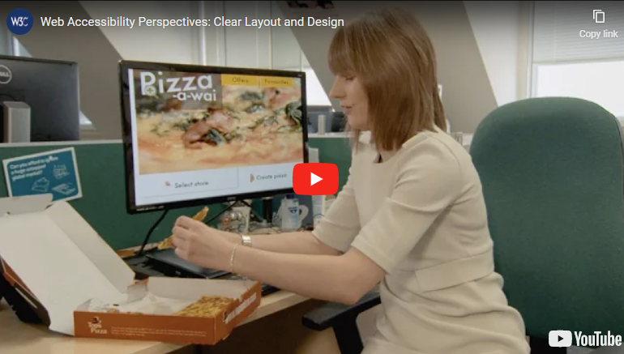
Web accessibility benefits everyone
Clear layout and design is essential for people with low vision and people with learning and cognitive disability.
Clear Layout and Design (video, 1:06 min) https://www.w3.org/WAI/perspective-videos/layout/
Notes:
Age.. If we live enough, we will sure live change in our abilities !

Slide 11
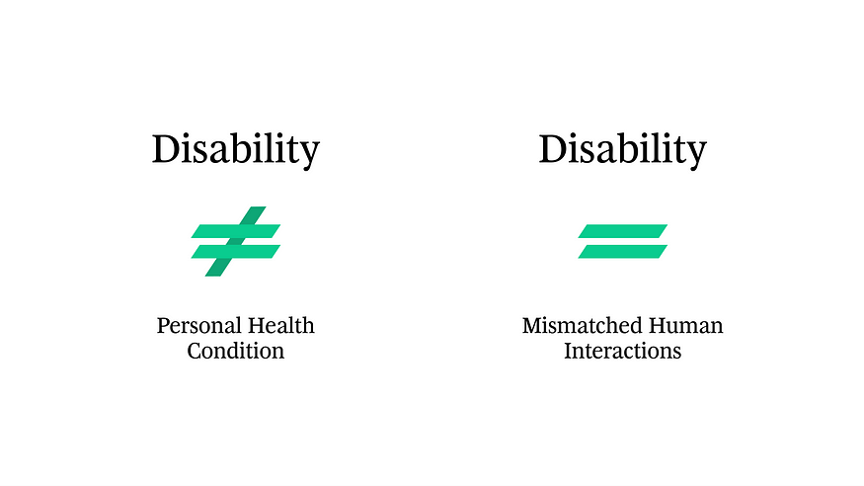
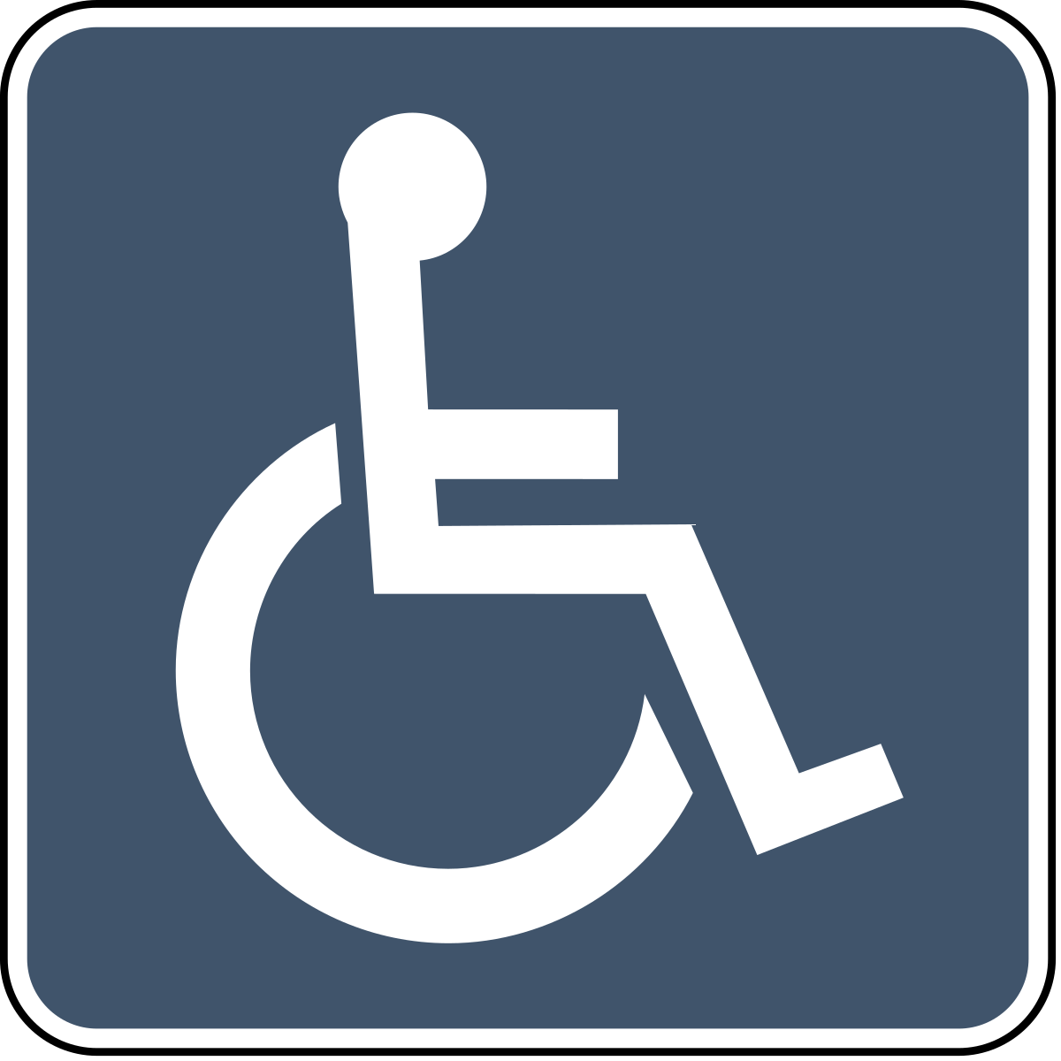
Disability in the eyes of societies (outdated model)
Back in 1980, a disability was defined “In the context of health experience, a disability is any restriction or lack of ability (resulting from an impairment) to perform an activity in the manner or within the range considered normal for a human being.” – World Health Organization, 1980
Medical model (outdated)
Medical Model (outdated)
Disabled | = Less Able
Responsibility of | Person with an impairment to overcoming barriers
Focus | Prevention, treatment or curing of the disabling condition
Personal health condition

Slide 12

Disability in the eyes of societies (today)
Today, disability is defined as "a mismatch in interaction between the features of a person's body and the features of the environment in which they live“ - The World Health Organization
Social model
Social Model
Disabled | = Disabled by social barriers
Responsibility of | Governments and everyone to build more equal and inclusive society
Focus | Ways to provide accessibility, enables people rather than disables them.
Mismatched human interaction

Slide 13
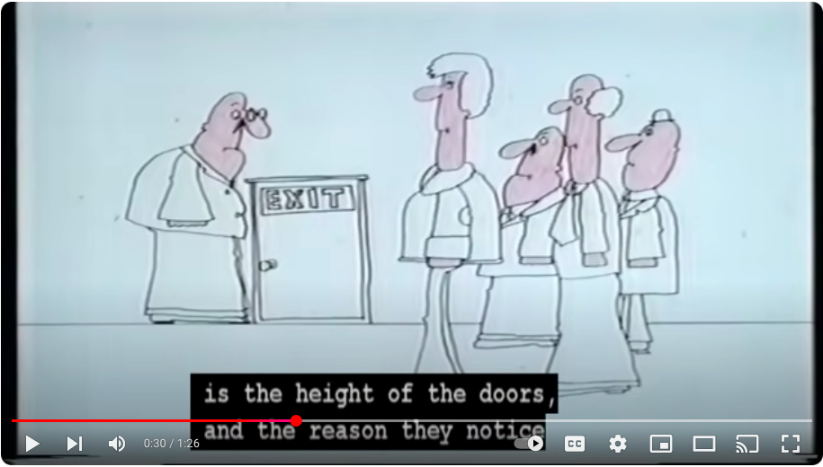
Disability in the eyes of societies
Social Model Animation (Video, 1:27min)
https://www.youtube.com/watch?v=9s3NZaLhcc4

Slide 14
Disability in the eyes of societies
Notes:
The social modal, says that a person doesn’t have a disability, but they are disabled by society that prevents them from achieving their potential.

Slide 15
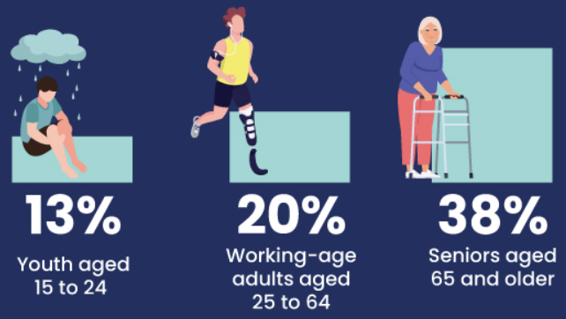
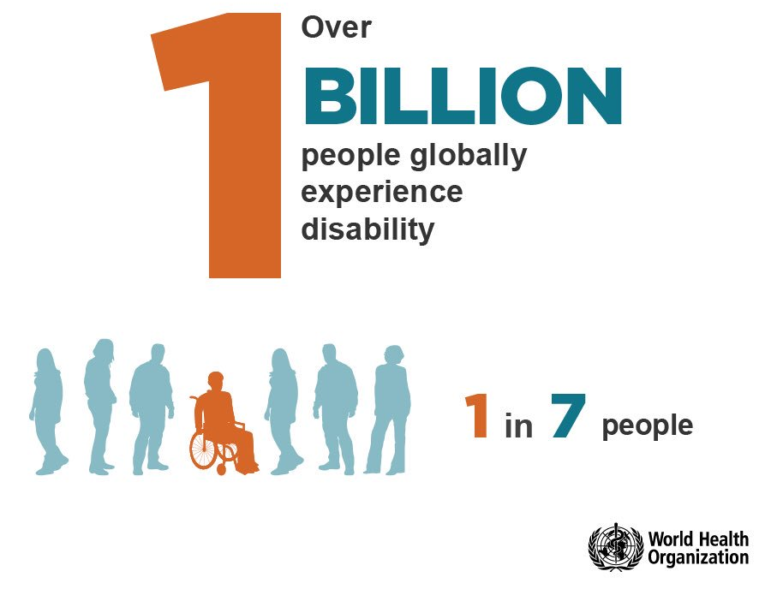
Measuring disability in Canada
In 2017, 6.2 million (22%) Canadians aged 15 and older had a disability. This is based on a social model of disability.
The world
24%
Women
20%
Men
By Age group
The 2017 Canadian Survey on Disability (CSD)
Notes:
The 2017 CSD collected data on experiences of persons with disabilities is based on a social model of disabilities, which considers disability to be the result of the interaction between a person’s functional limitations and barriers in the environment, including social and physical barriers that make it harder to function day to day.

Slide 16
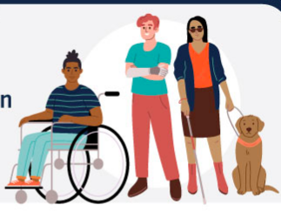
Measuring disability in Canada
In 2022, 27.0% of Canadians aged 15 and over, or 8.0 million people, had at least one disability. This represents an increase of 4.7 percentage points from 2017.
https://www150.statcan.gc.ca/n1/pub/11-627-m/11-627-m2023063-eng.htm

Slide 17
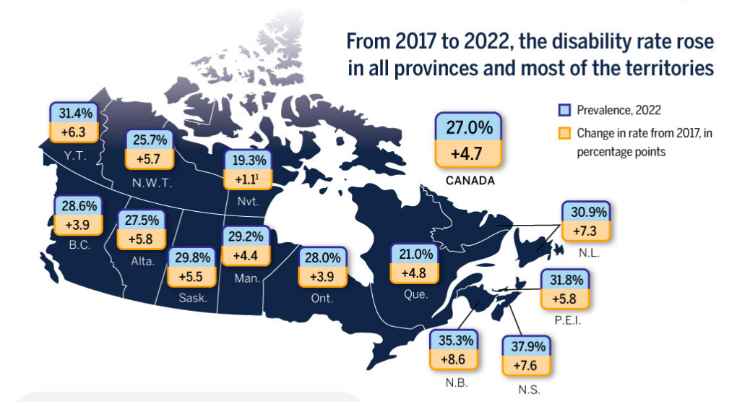
Measuring disability in Canada
https://www150.statcan.gc.ca/n1/pub/11-627-m/11-627-m2023063-eng.htm

Slide 18
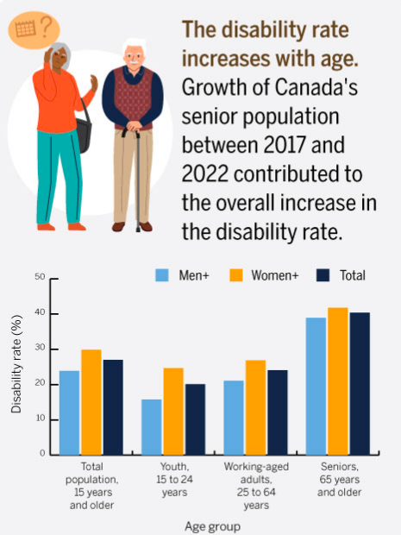
Measuring disability in Canada
https://www150.statcan.gc.ca/n1/pub/11-627-m/11-627-m2023063-eng.htm

Slide 19
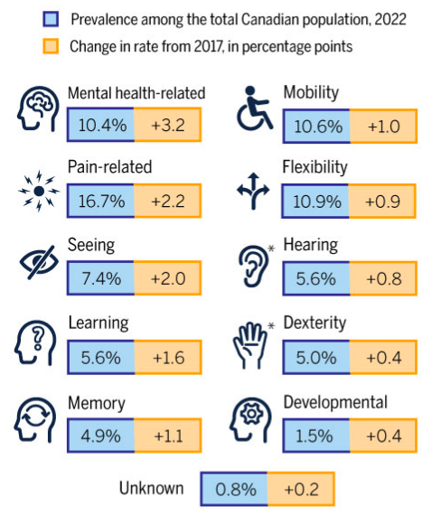
Measuring disability in Canada
https://www150.statcan.gc.ca/n1/pub/11-627-m/11-627-m2023063-eng.htm

Slide 20
ICT accessibility in Federal Sector Organizations in Canada, 2021
Among those who interacted with federal sector organizations in the past two years, Canadians with disabilities, difficulties or long-term conditions encountered an Information and Communication Technology (ICT) barrier.
Types of ICT activities with barriers:
Type of activity | Experienced a barrier (percent %)
Watching TV shows, movie, or other content through traditional television platforms | 22.0
Using in person self-serve technology | 27.2
Online access to federal government information, services or supports * | 24.3
Online access to federally regulated businesses | 19.1
* Services or supports (24.3%): This could include such online activities as applying for Employment Insurance or Disability Benefits, completing a passport application, or filing tax forms.
Accessibility in Federal Sector Organizations in Canada, 2021

Slide 21
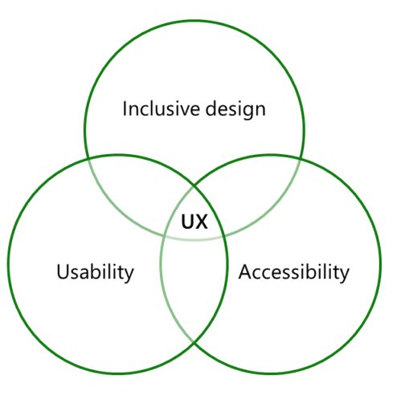
Accessibility, inclusion, usability & user experience
A good user experience (UX ) means consideration of inclusive design, usability and accessibility to make IT solutions and equipment usable by all.
Usable by All is the overarching goal of the Accessible Canada Act (check related slide later)
Notes:
Accessibility focuses on disability and does not try to address broader issues.
Inclusive design is about diversity, including diverse users and consideration of everyone including people with disability are considered. Inclusion is a method and not a process for meeting standards (accessibility has standards to meet).
Usability means that a website is intuitive and easy to use. It is measured by
Effectiveness: Can you accomplish the task – and the accuracy
Efficiency: Can the user accomplish the task in an ideal timeframe
Satisfaction: Do users like the application? measures the extent to which users are free from discomfort, and their attitudes towards the use of the product
An example of a good user experience is that you include diversity of people in the design phase of the product, test it with them during and after development. Design with users, iterate and improve in response to user needs, build in accessibility from the start.

Slide 22
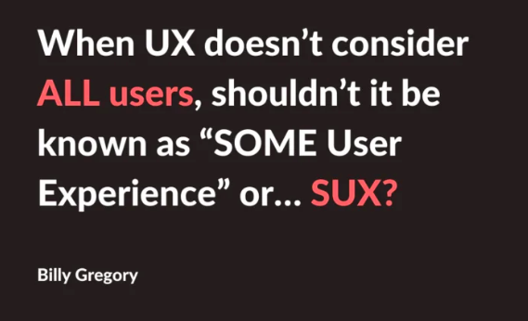

Slide 23
Accessibility requirements
Guidelines and federal & provincial legislations for Information and Communications Technology (ICT)

Slide 24
The Business Case for Digital Accessibility
“Many organizations are waking up to the fact that embracing accessibility leads to multiple benefits – reducing legal risks, strengthening brand presence, improving customer experience and colleague productivity.” - Paul Smyth, Head of Digital Accessibility, Barclays
Accessibility can:
Drive Innovation
Enhance Your Brand:
Extend Market Reach
Minimize Legal Risk
Read more: The Business Case for Digital Accessibility, WAI-W3C
Notes:
Sometimes, we need to sell the idea of making a product accessible
Accessibility can:
Drive Innovation: Accessibility features in products and services often solve unanticipated problems.
Enhance Your Brand: Diversity and inclusion efforts so important to business success are accelerated with a clear, well-integrated accessibility commitment.
Extend Market Reach: The global market of people with disabilities is over 1 billion people with a spending power of more than $6 trillion. Accessibility often improves the online experience for all users.
Minimize Legal Risk: Many countries have laws requiring digital accessibility, and the issue is of increased legal concern.

Slide 25
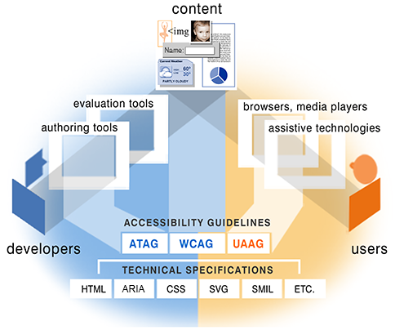
Essential components of web accessibility
Web accessibility depends on the cooperation of seven components:
Content (text, images, sounds, code, markup, presentation)
User agents (web browsers, media players)
Assistive technologies (screen readers, keyboards, switches)
Users’ knowledge and experiences (user behaviours)
Developers (designers, coders, authors)
Authoring tools (software that creates websites, content)
Evaluation tools (HTML validators, CSS validators)
WAI-ARIA*
Essential Components of Web Accessibility * WAI-ARIA ADDED. Not in the original graphic
Notes:
Let’s see together how these components work in an example of producing an accessible image (an accessible image must have an alt attribute).
To add an image on a web page:
The developer is aware that alt is required for the image
The developer uses a software or CMS i.e., WordPress to add the image
The software supports the alt attribute; gives the option with a right click on the image to enter the text of the alt
Then the developer validates the code with a tool like the W3C validator tool,
The W3c Validator tool supports the alt attribute; verifies whether the alt attribute exists on the image.
The page is online. The user uses chrome to see the page with the image
The browser supports the alt attribute; passes the alt to the user and API accessibility for NVDA screen reader
A blind person uses JAWS
Jaws supports the alt attribute; recognizes the alt value and reads it for the user
W3C guidelines put the rules on accessibility for each component via the accessibility guidelines.
When an accessibility feature (such as alt on image) is supported by all components we will have an accessible product.
But if one of the components of the support not, it will be demotivating for others to use it And by consequence of the less accessible web products

Slide 26
W3C Accessibility Guidelines
WCAG
WAI-ARIA
ATAG
UAAG
web content
advanced web app
authoring tools
browsers
Web Content Accessibility Guidelines (WCAG)
WCAG focuses on making web content accessible to people with disabilities, such as visual, auditory, and cognitive impairments.
Accessible Rich Internet Applications Suite (WAI-ARIA) or ARIA
It especially helps with dynamic content and advanced user interface controls developed with HTML, JavaScript, and related technologies.
W3C Authoring Tool Accessibility Guidelines (ATAG)
ATAG focuses on making authoring tools accessible, such as content management systems and web design software, more accessible to content creators with disabilities. The guidelines cover the entire authoring process, from creating, editing, and publishing web content..
User Agent Accessibility Guidelines (UAAG)
UAAG provides guidelines for making web user agents, such as web browsers and media players, more accessible. The guidelines cover a range of features, such as keyboard navigation, text resizing, and audio descriptions, that make it easier for people with disabilities to use web content.
Our focus in this course is on WCAG and WAI-ARIA
Notes:
WCAG and WAI-ARIA for developers, designers and page authors who produce websites, web applications and mobile apps.
Authoring Tool Accessibility Guidelines (ATAG) 2.0 for developers of software programs like Dreamweaver, WordPress and all software that can saves output in HTML.
User Agent Accessibility Guidelines (UAAG) for developers of web browsers, media players, all that reads the code and presents it to the user.

Slide 27
ICT accessibility legislations
Canada, Ontario Accessibility for Ontarians with Disabilities Act (AODA)
Canada, Federal Accessible Canada Act (ACA)
Europe EN 301 549: European standard for digital accessibility
United States (US) Americans with Disabilities Act (ADA)
US, Federal US Section 508 guidelines
Notes:
Scope of Information and Communications Technology (ICT) in accessibility legislations:
web pages, electronic content, telecommunications products,
computers and ancillary equipment, software including mobile applications, information kiosks and transaction machines,
videos, IT services, and multifunction office machines which copy, scan, and fax document

Slide 28
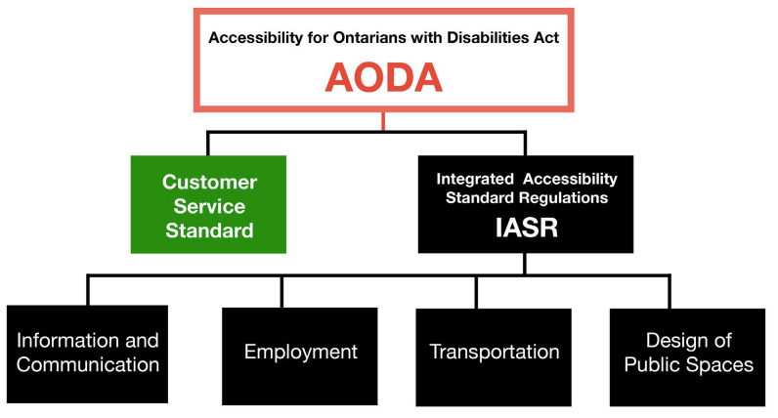
Accessibility for Ontarians with Disabilities Act (AODA)
AODA aims to make Ontario fully accessible for people with disabilities by 2025.
Information and Communications Standard
Ensures that all information and communications* provided by organizations in Ontario are accessible to people with disabilities.
By January 1, 2025: All public websites and web content must conform to WCAG 2.0 Level AA, including live captioning and pre-recorded audio descriptions.
Compliance with the WCAG 2.0 Level AA is a legal requirement under the AODA and failure to comply can result in penalties and fines.
* Information and communications includes websites, public information, and communications with customers and employees.
The five AODA standards
How to make websites accessible, Accessibility in Ontario, Ontario
Graphic source: Handbook on AODA, Ontario Business Improvement Area Association (OBIAA) PDF
Notes:
There are five AODA standards. The Customer Service Standard was the first standard to become law in 2008.
The information and communications, employment, transportation, and design of public spaces standards have been combined under one regulation called the Integrated Accessibility Standards Regulation (IASR). These five standards are now law and the requirements are being phased in over time. The phased-in approach gives businesses and organizations time to make accessibility a part of their daily business.

Slide 29
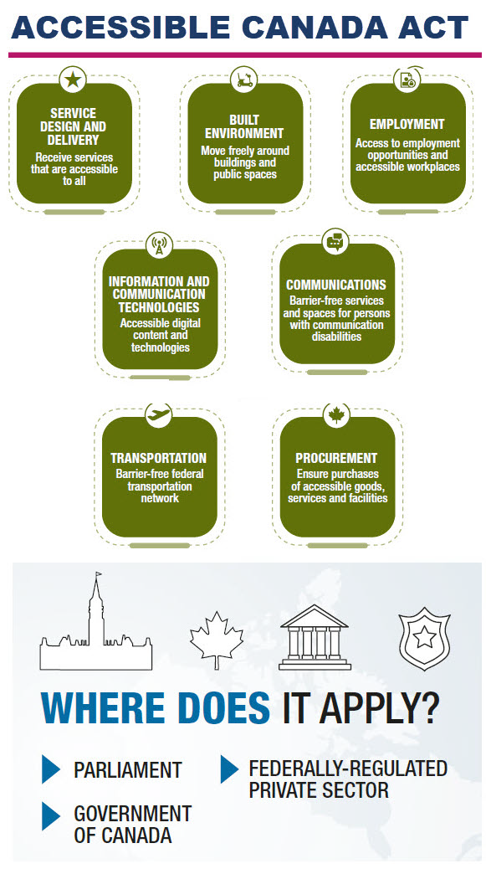
Accessible Canada Act (ACA)
#Nothing without us , #Usable by All
It came into force in 2019. The overarching goal of ACA is to realize a barrier-free Canada by 2040.
Government of Canada Information and Communication technologies (ICT)* accessibility strategy
Make information and communications technology usable by all regardless of ability or disability.
Current state (not sufficient to meet ACA) | Desired state
Standard on Web Accessibility WCAG 2.0 AA | Harmonised European Standard, EN 301 549 (2018) WCAG 2.1 AA
Cover only externally public facing websites Target government of Canada clients Does not cover other aspects of ICT | Cover external and internal Target clients and employees Cover all ICT *
The 7 priority areas of Accessible Canada Act
Examples of ICT are web pages, electronic content, telecommunications products, computers and ancillary equipment, software including mobile applications, information kiosks and transaction machines, videos, IT services, and multifunction office machines which copy, scan, and fax document
Technology: Accessibility Strategy for the Public Service of Canada , Guideline on Making Information Technology Usable by All
Graphic source: Accessible Canada Act – visual representation 2
Notes:
Towards an Accessible Canada , The ACA applies to a wide range of federally regulated entities. This includes, for example:
industry sectors such as banking, telecommunications and transportation
Government of Canada departments and agencies
Parliament
Crown corporations
Canadian Armed Forces
Royal Canadian Mounted Police, and
First Nations band councils
The ACA requires regulated entities to prepare and publish accessibility plans, set up feedback processes and report openly on progress. The ACA gives the authority to create and enforce accessibility regulations.
With the ACA coming into force in 2019 , the Accessibility Strategy was launched in 2019 as well to help the public service lead by example in accessibility and to prepare organizations for the Accessible Canada Act. The Accessibility Strategy has 5 priority areas: Employment; Built Environment; Technology; Services; and Culture.
The government of Canada Accessibility strategy for

Slide 30
EN 301 549: European standard for digital accessibility
European standard of Accessibility requirements for ICT products and services in the European Union.
Adopts the latest version of the W3C’s Web Content Accessibility Guidelines (WCAG), in this case, it directly references WCAG 2.1 AA
Includes requirements for the procurement of accessible ICT products and services by public sector organizations in Europe.
Many governments guidelines including Government of Canada encourage alignment with EN 301 549
Read more What is EN 301 549 (Video 9:53 min)

Slide 31
Americans with Disabilities Act (ADA)
European standard of Accessibility requirements for ICT products and services in the European Union.
Requires that websites to be accessible to people with disabilities
No specific standard
Many law suitcases in the States!

Slide 32
US Section 508 guidelines
US Section 508 guidelines were developed by the US Access Board for use by federal agencies in implementing Section 508 of the US Rehabilitation Act. Federal agencies use the Section 508 guidelines to develop, procure, maintain, and use accessible Information and Communication Technology (ICT). The guidelines contain scoping and technical considerations to facilitate accessibility for individuals with disabilities.
Section 508 and 255 (Revised 2017)
Read more Section 508 of the Rehabilitation Act of 1973

Slide 33
Diversity of users and accessibility barriers
Types of disabilities and ways to improve the user experience.

Slide 34
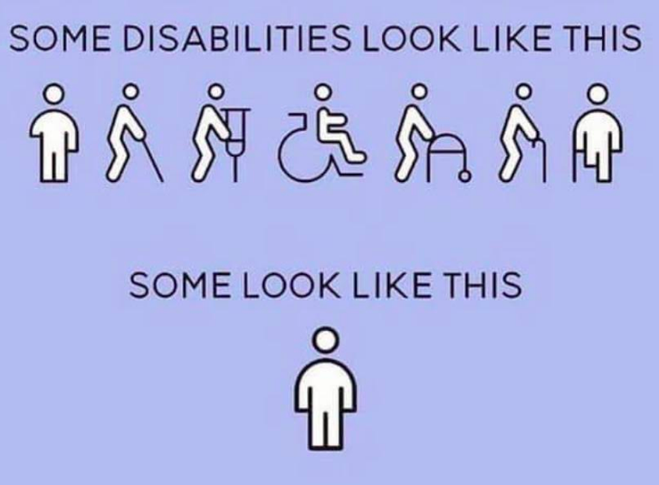

Slide 35
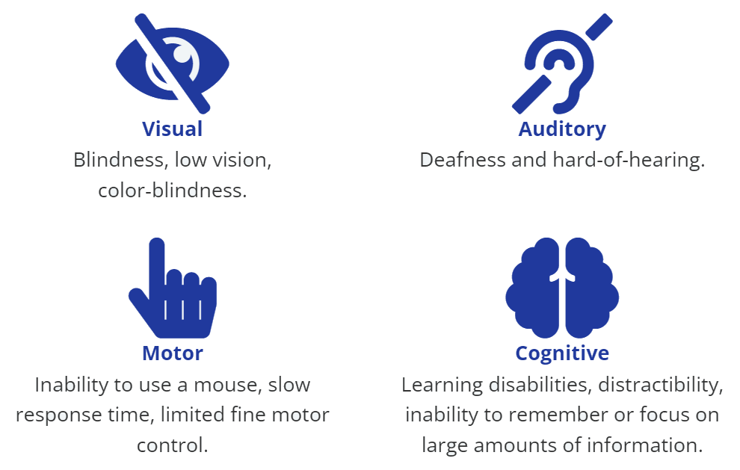
Categories of disabilities
Cognitive disabilities also known as invisible disabilities
Graphic source: People with Disabilities on the Web.
Read more The barriers encountered by different types of disabilities
Notes:
Not all people with disabilities encounter barriers on the Web, and those with different types of disabilities encounter different types of barriers. For instance, if a person is in a wheelchair they may encounter no barriers at all in web content. A person who is blind will experience different barriers than a person with limited vision. Different types of disabilities and some of their commonly associated barriers are described here.

Slide 36
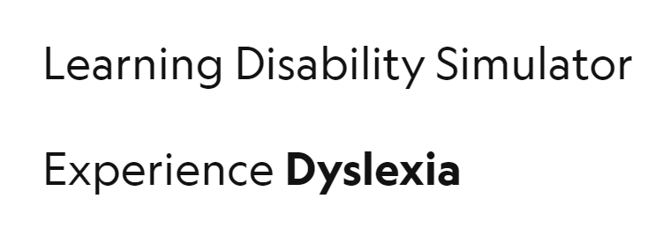
Activity: Experiment Dyslexia
Dyslexia will scramble the letters and make them dance.
You have two minutes to read the text. Afterwards, you will be asked some questions.
Questions to discuss after the experiment:
Were you able to complete the reading?
Could you answer the questions?
How did you feel during the activity?
How to create a dyslexia friendly web content?
Learning disability simulator: Experience dyslexia
https://youtu.be/69OWA6mFII4
Credit: This experiment was created by Funkify Disability Simulator
Notes:
Original text used in the dyslexia experiment https://education.nationalgeographic.org/resource/beyond-king-tut/
Short checklist for building dyslexia friendly websites and apps:
Complement text content with video, images, illustrations and diagrams.
Avoid ``wall of text``. Keep paragraphs short, structure with headings and use lots of bullet lists.
Use a simple language with active verbs.

Slide 37
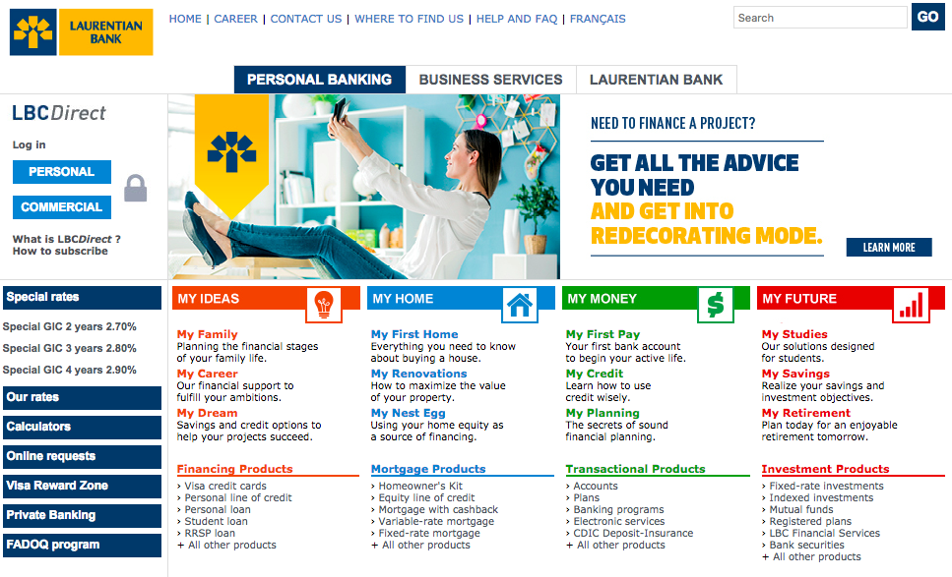
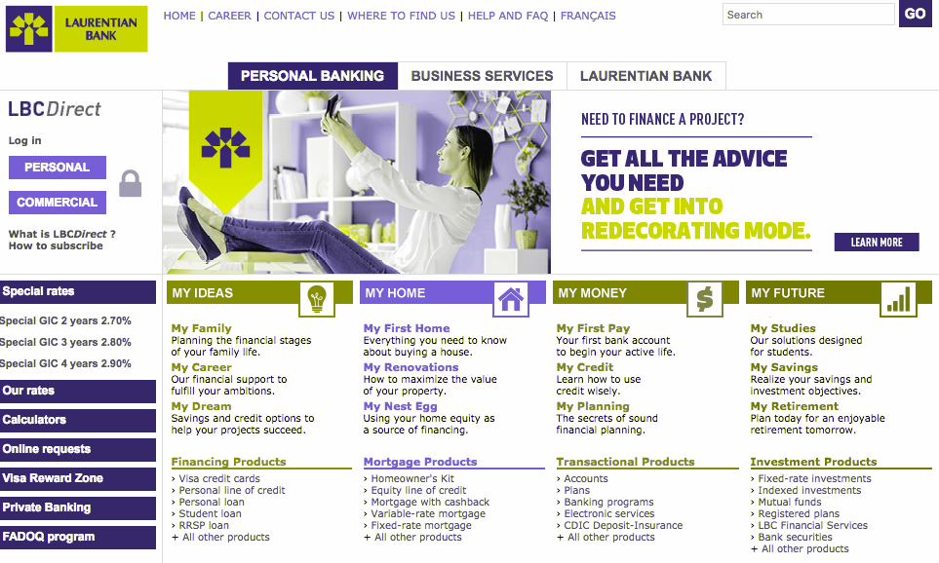
Disability Simulators
Vision loss: Vision simulation, video 2 min
Color blindness
Notes:
Original text used in the dyslexia experiment https://education.nationalgeographic.org/resource/beyond-king-tut/
Short checklist for building dyslexia friendly websites and apps:
Complement text content with video, images, illustrations and diagrams.
Avoid ``wall of text``. Keep paragraphs short, structure with headings and use lots of bullet lists.
Use a simple language with active verbs.

Slide 38
Lab: Experience the web with vision impairment
Let’s Experience the web with vision impairment!
Lab 1

Slide 39
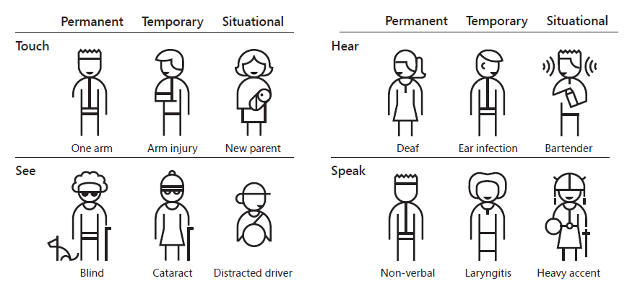
Types of disabilities
Microsoft Persona Spectrum: creating products for people with permanent disabilities creates results that benefit those with temporary disabilities and others with limiting situations
Read more: Inclusive 101 Guidebook (PDF), Microsoft Inclusive Design
Notes:
We all have abilities and limits to those abilities.
Our abilities changes with situation.. When you are stressed, you may lack concentration.
i.e. a solution that works well for someone who’s blind might also benefit any person driving a car. Someone with low vision would benefit from increased color contrast, same as a person who reads on a mobile in the sun.
https://webaim.org/articles/seizure/#vestibular
Vestibular Disorders are caused by parts o the inner ear and brain that process the sensory information involved with controlling balance and eye movements.
The following items can result in difficulties for users with vestibular disorders:
High contrast graphics with tight parallel lines.
Animated scrolling that lasts longer than perhaps 1/4 second.
Parallax or reverse parallax—simultaneous foreground and background scrolling in different directions or at different speeds.
Moving images beneath static text.

Slide 40
Activity: Gaming experience that is accessible by design
Many people with disabilities play video games. *
Identify elements that can introduce challenges for gamers with disabilities and reflect on how to make this interactive experience accessible by design.
Accessibility barriers in a gaming experience:
Visual barriers, video (6min)
Hearing barriers, video (6min)
Cognitive barriers, video (5min, 47sec)
Mobility and input barriers, video (3min, 33 sec)
* Vendors claim that 92% of people with impairments play video games, there are nearly 400 million players with disabilities in the world, there are more than 33 million gamers with disabilities in the U.S. alone.
Read more: Gaming accessibility fundamentals, Xbox, Microsoft
Notes:
In each of these videos, we will stop at a few gaming shots and have a discussion on the barriers and reflect on how the user experience can be improved.

Slide 41
Conclusion
In this lesson, we covered topics related to the understanding accessibility.
You learned about accessibility, inclusion and usability, the W3C standards and legislations related to accessibility and the categories of impairments. In addition, you experienced the barriers that some people with disabilities may encounter on the Web.
In the next lesson, you will revise the basics of HTML, CSS and JavaScript and learn about assistive technologies and WAI-ARIA

Slide 42
Using GitHub
Many of the assignments will require you to work on GitHub. In the following steps, you will familiarize yourself with the use of GitHub.
Week1 - Using GitHub on brightspace

